Slide 1

Defect-based and Experience-based Techniques
Software Quality Assurance
Telerik Software Academy
http://academy.telerik.com

Slide 2


The Lectors
Snejina Lazarova
Product Manager
Talent Management System
Asya Georgieva
Junior QA Engineer
Telerik Academy & AppBuider

Slide 3

Table of Contents
Defect Taxonomies
Checklist Testing
Error Guessing
Exploratory Testing

Slide 4

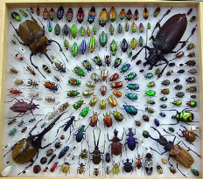
Defect Taxonomies
Using Predefined Lists of Defects

Slide 5
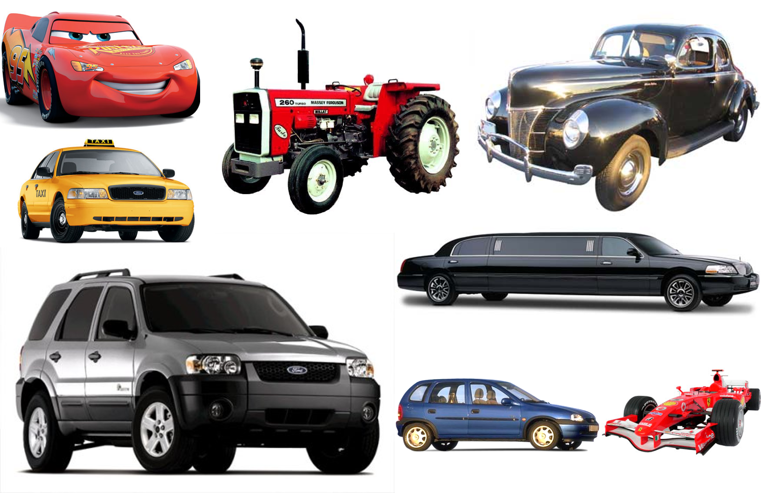
Classify Those Cars!

Slide 6
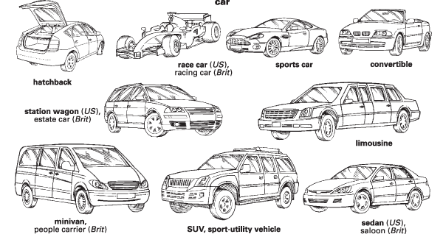
Possible Solution?

Slide 7
Possible Solution? (2)
Black
White
Red
Green
Blue
Another color
Up to 33 kW
34-80 kW
81-120 kW
Above 120 kW
Real
Imaginary

Slide 8
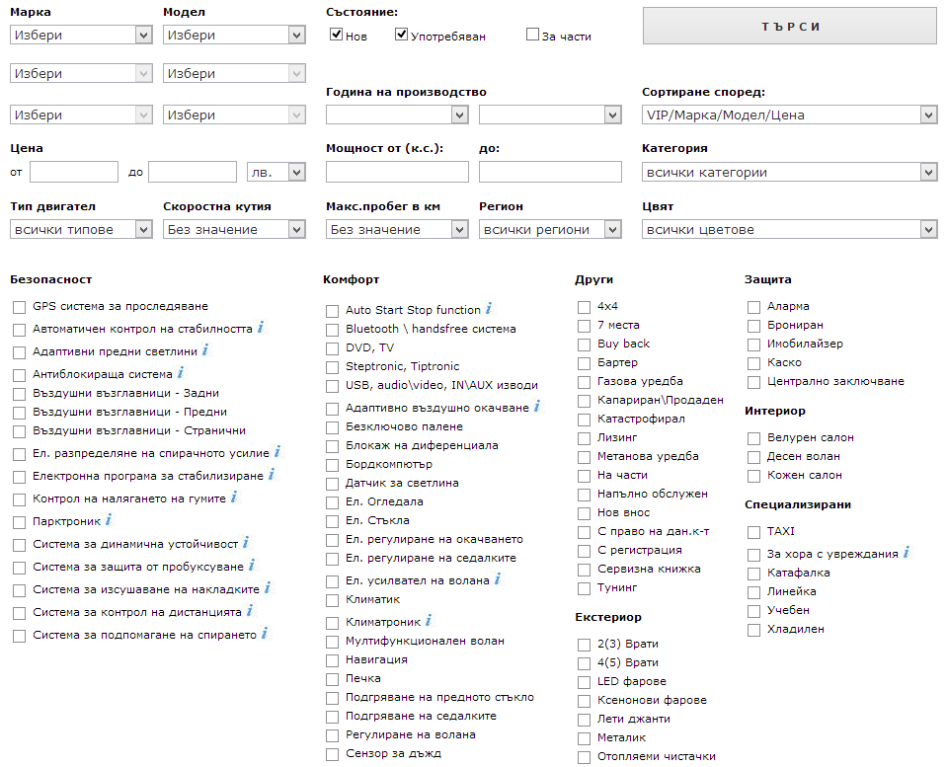
But maybe you don’t need to!

Slide 9
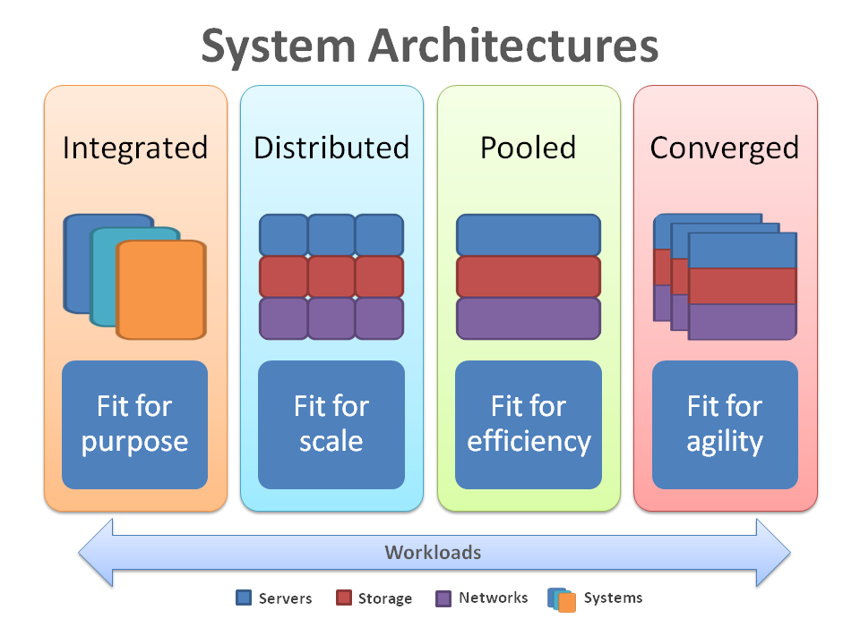
Taxonomy in Computer Science

Slide 10
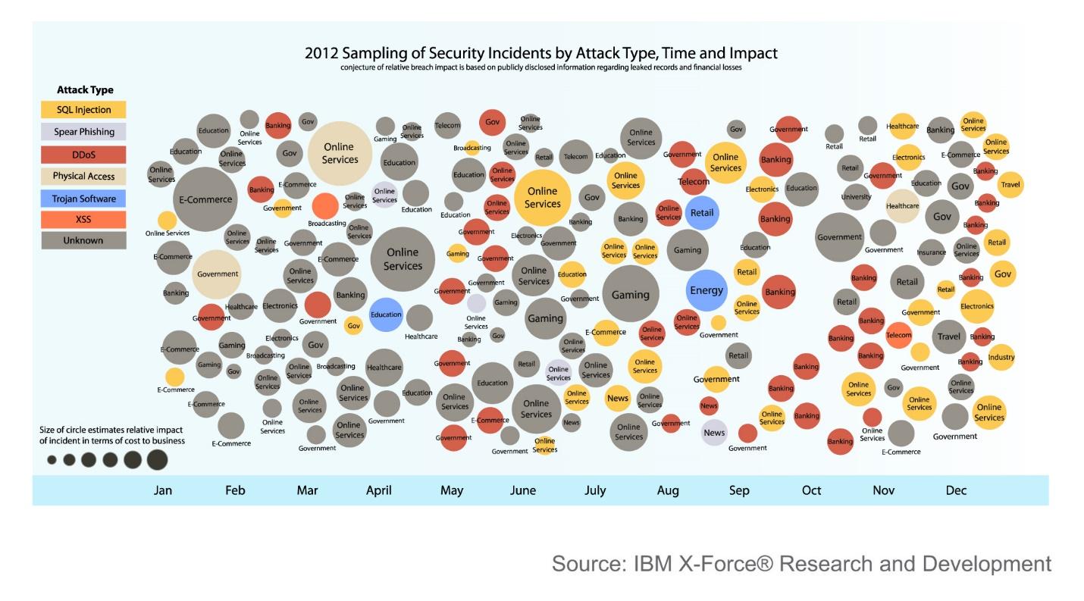
Taxonomy in Computer Science (2)

Slide 11
Taxonomy in Software Testing
Testing
Static
Dynamic
Review
Static Analysis
Black-box
White-box
Experience-based
Defect-based
Dynamic analysis
Functional
Non-functional

Slide 12
Defect Taxonomy
Defect Taxonomy
Many different contexts
Hard to pinpoint one definition
A system of (hierarchical) categories designed to be a useful aid for reproducibly classifying defects

Slide 13
Purpose of a Defect Taxonomy
A Good Defect Taxonomy for Testing Purposes
Is expandable and ever-evolving
Has enough detail for a motivated, intelligent newcomer (like you:) to be able to understand it and learn about the types of problems to be tested for
Can help someone with moderate experience in the area (like me) generate test ideas and raise issues

Slide 14
Defect-based Testing
We are doing defect-based testing anytime the type of the defect sought is the basis for the test
The underlying model is some list of defects seen in the past
If this list is organized as a hierarchical taxonomy, then the testing is defect-taxonomy based

Slide 15

The Defect-based Technique
The Defect-based Technique
A procedure to derive and/or select test cases targeted at one or more defect categories
Tests are being developed from what is known about the specific defect category

Slide 16
Defect Based Testing Coverage
Creating a test for every defect type is a matter of risk
Does the likelihood or impact of the defect justify the effort?
Creating tests might not be necessary at all
Sometimes several tests might be required

Slide 17
The Bug Hypothesis
The underlying bug hypothesis is that programmers tend to repeatedly make the same mistakes
I.e., a team of programmers will introduce roughly the same types of bugs in roughly the same proportion from one project to the next
Allows us to allocate test design and execution effort based on the likelihood and impact of the bugs

Slide 18
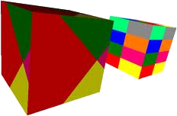
Practical Implementation
Most practical implementation of defect taxonomies is Brainstorming of Test Ideas in a systematic manner
How does the functionality fail with respect to each defect category?
They need to be refined or adapted to the specific domain and project environment

Slide 19

Brainstorming Test Ideas

Slide 20
What are the different ways an e-commerce shopping card can fail?
Without Taxonomy
With Taxonomy

Slide 21
Brainstorming session
Without a taxonomy
Shopping cart does not load
Unable to add/remove item
Unable to modify order
Correct item not added
Hidden functionality, not able to find checkout button
Broken URLs
Missing URLs
Able to hack the cart and change prices from client side
Customer credit card numbers compromised due to security glitch
Too generic
Database issue
Usability
Not exactly helpful
Security
And what about Performance, Accessibility, Scalability?

Slide 22
Brainstorming session (2)
With the taxonomy
The user cannot add an item directly from the search result page
Test for vulnerability to SQL query attacks
System Security
Network Failures
Poor Usability
How does the functionality fail with respect to each category?
Removing/adding an item from the cart does not update the total
Link to inventory database goes down
Timeouts of requests during peak hours
Scalability
Calculation/computation errors

Slide 23


Checklist Testing

Slide 24
What is Checklist Testing?
Checklist-based testing involves using checklists by testers to guide their testing
The checklist is basically a high-level list (guide or a reminder list) of
Issues to be tested
Items to be checked
Lists of rules
Particular criteria
Data conditions to be verified

Slide 25

What is Checklist Testing? (2)
Checklists are usually developed over time on the base of
The experience of the tester
Standards
Important functional areas
Previous trouble-areas

Slide 26
Checklist Testing in Methodical Testing
The list should not be a static
Generated at the beginning of the project
Periodically refreshed during the project through some sort of analysis, such as quality risk analysis

Slide 27
Exemplary Checklist
A checklist for usability of a system could be:
Accessibility
Site load-time is reasonable
Font size/spacing is easy to read
Adequate text-to-background contrast
Layout
Important content is displayed first
Related information is grouped together clearly

Slide 28

Exemplary Checklist (2)
A checklist for usability of a system could be:
Navigation
Navigation is constant on every page
Links are consistent & easy to identify
Site search is easy to access
Important links aren’t placed in moving features
Notes:
A good example for real-life checklist:
http://www.eply.com/help/eply-form-testing-checklist.pdf
Usability checklist:
http://userium.com/

Slide 29
Advantages of Checklist Testing
Checklists can be reused
Saving time and energy
Help in deciding where to concentrate efforts
Valuable in time-pressure circumstances
Prevents forgetting important issues
Offers a good structured base for testing
Helps spreading valuable ideas for testing among testers and projects

Slide 30
Recommendations
Checklists should be tailored according to the specific situation
Use checklists as an aid, not as mandatory rule
Standards for checklists should be flexible
Evolving according to the new experience

Slide 31
Testing Techniques Chart
Testing
Static
Dynamic
Review
Static Analysis
Black-box
White-box
Experience-based
Defect-based
Dynamic analysis
Functional
Non-functional

Slide 32
Experience-based Techniques
Tests are based on people's skills, knowledge, intuition and experience with similar applications or technologies
Knowledge of testers, developers, users and other stakeholders
Knowledge about the software, its usage and its environment
Knowledge about likely defects and their distribution

Slide 33

Error Guessing
Good Testers DO NOT Guess!

Slide 34
What is Error Guessing?
They build hypothesis where a bug might exist based on
Previous experience
Early cycles
Similar systems
Understanding of the system under test
Design method
Implementation technology
Knowledge of typical implementation errors

Slide 35

Error “guessing”
Error “guessing” is not in itself a technique, but rather a skill that can and should be applied to all of the other testing techniques
WHY?
Because it can make our testing more effective
and WHY?
To produce fewer tests that could catch most of the bugs!
but WHY?
To bring more value to the project!
WHY? WHY? WHY?
Because it makes you feel smart ☺

Slide 36
Objectives of Error Guessing
Focus the testing activity on areas that have not been handled by the other more formal techniques
E.g., equivalence partitioning and boundary value analysis
Intended to compensate for the inherent incompleteness of other techniques
Complement equivalence partitioning and boundary value analysis

Slide 37
How to Improve Your Error Guessing Techniques?

Slide 38
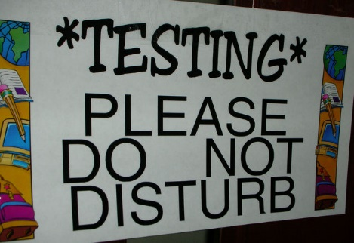
Spend more time…

Slide 39
Improve your technical understanding
Talk with Developers
Learn how things are implemented
Understand software architectures and design patterns
Dive into the code
Learn to code

Slide 40

Look for errors not only in the code
Errors also can exist in
Requirements
Design
Testing itself
Usage

Slide 41
Experience Required
Testers who are effective at error guessing use a range of experience and knowledge:
Knowledge about the tested application
E.g., used design method or implementation technology
Knowledge of the results of any earlier testing phases
Particularly important in Regression Testing

Slide 42

Experience Required (2)
Testers who are effective at error guessing use a range of experience and knowledge:
Experience of testing similar or related systems
Knowing where defects have arisen previously in those systems
Knowledge of typical implementation errors
E.g., division by zero errors
General testing rules

Slide 43
More Practical Definition
Error guessing involves asking
"What if…"

Slide 44

Effectiveness
Different people with different experience will show different results
Different experiences with different parts of the software will show different results
As tester advances in the project and learns more about the system, he/she may become better in Error Guessing

Slide 45
Why using it?
Advantages of Error Guessing
Highly successful testers are very effective at quickly evaluating a program and running an attack that exposes defects
Can be used to complement other testing approaches
It is more a skill then a technique that is well worth cultivating
It can make testing much more effective

Slide 46
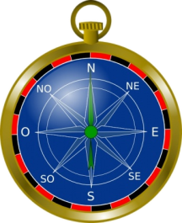
Exploratory Testing
Learn, Test and Execute Simultaneously

Slide 47

What is Exploratory Testing?
What is Exploratory Testing?
Simultaneous test design, test execution, and learning.
James Bach, 1995

Slide 48
What is Exploratory Testing? (2)
What is Exploratory Testing?
Simultaneous test design, test execution, and learning, with an emphasis on learning.
Cem Kaner, 2005
The term "exploratory testing" is coined by Cem Kaner in his book "Testing Computer Software"

Slide 49
What is Exploratory Testing?(3)
What is Exploratory Testing?
A style of software testing that emphasizes the personal freedom and responsibility of the individual tester to continually optimize the quality of his/her work by treating test-related learning, test design, test execution, and test result interpretation as mutually supportive activities that run in parallel throughout the project.
2007

Slide 50

What is Exploratory Testing? (4)
Exploratory testing is an approach to software testing involving simultaneous exercising the three activities:
Learning
Test design
Test execution

Slide 51
Control as You Test
In exploratory testing, the tester controls the design of test cases as they are performed
Rather than days, weeks, or even months before
Information the tester gains from executing a set of tests then guides the tester in designing and executing the next set of tests

Slide 52
When we are doing Exploratory Testing
Any testing techniques can be used in an exploratory way!
All testing is exploratory in some way…
But a skilled exploratory testing is what we aim for!

Slide 53
How we are doing it?
As long as the tester is thinking and learning while testing and the next tests are influenced by the learning
Anytime the next test we do is influenced by the result of the last test we did

Slide 54
Exploratory Testing
Exploratory testing is an approach to software testing involving simultaneous
Learning
Test design
Test execution
The tester is in control of testing now!
Good testers doesn’t just ask pass or fail… but rather “Is there a problem here?”

Slide 55

It is like playing chess
The process of chess remain constant, it’s only the choices that change, and the skill of the players who choose the next move

Slide 56

Testing is all about exploration, discovery, investigation, and learning
It is a conscious process
Testing can be assisted by machines, but can’t be done by machines alone

Slide 57

When Do We Use ET?
When do we use exploratory testing (ET)?
Anytime the next test we do is influenced by the result of the last test we did
We become more exploratory when we can't tell what tests should be run, in advance of the test cycle

Slide 58

Exploratory vs. Ad hoc Testing
Exploratory testing is to be distinguished from ad hoc testing
The term "ad hoc testing" is often associated with sloppy, careless, unfocused, random, and unskilled testing

Slide 59

Is This a Technique?
Exploratory testing is not a testing technique
It’s a way of thinking about testing
Capable testers have always been performing exploratory testing
Widely misunderstood and foolishly disparaged
Any testing technique can be used in an exploratory way

Slide 60
Scripted Testing vs. Exploratory
A Script (low level test case) specifies
the test operations
the expected results
the comparisons the human or machine should make
These comparison points are useful in general, but many times fallible and incomplete, criteria for deciding whether the program behaves properly
Scripts require a big investment
to create
even more to maintain and keep them up to date

Slide 61
Benefits of Scripting Testing
Careful thinking about the design of each test, optimizing it for its most important attributes
Review by other stakeholders
Reusability
Can be helpful for building regression automation suite from another person
Known comprehensiveness of the set of tests
If we consider the set sufficiently comprehensive, we can calculate as a metric the percentage completed of these tests

Slide 62
Drawbacks of Scripting Testing
Time sequence in scripted testing
Design the test early
Execute it many times later
Look for the same things each time
The high-cognitive work in this sequence is done during test design, not during test execution
We pay attention to some things and therefore we do not pay attention to others

Slide 63
Scripted vs. Exploratory Testing
Scripted Testing | Exploratory Testing
Directed from elsewhere | Directed from within
Determined in advance | Determined in the moment
Is about confirmation | Is about investigation
Is about controlling tests | Is about improving test design
Emphasizes predictability | Emphasizes adaptability
Emphasizes decidability | Emphasizes learning
Like making a speech | Like having a conversation
Like playing from a score | Like playing in a jam session

Slide 64
Concerns with Exploratory Testing
Depends heavily on the testing skills and domain knowledge of the tester
Limited test reusability
Limited test reusability
Limited reproducibility of failures
Cannot be managed
Low Accountability
Most of them are myths!

Slide 65
Session-Based Test Management
Software test method that aims to combine accountability and exploratory testing to provide rapid defect discovery, creative on-the-fly test design, management control and metrics reporting
Jonathan Bach, 2000

Slide 66
Session-Based Test Management
Elements:
Charter – includes a clear mission statement and areas to be tested
Session - an uninterrupted period of time spent testing
Reviewable result - session sheet test report
Debrief
Understand the session report
Learning and coaching

Slide 67
Session-Based Test Management
CHARTER
Analyze View menu functionality and report on areas of potential risk
AREAS
OS | Windows 7Menu | View Strategy | Function
Testing Start: 08.07.2013 10:00
End: 07.08.2013 11:00
Tester:

Slide 68
Session-Based Test Management
TEST NOTES
I touched each of the menu items, below, but focused mostly on zooming behavior with various combinations of map elements displayed.
View: Welcome Screen, Navigator, Locator Map, Legend, Map Elements Highway Levels, Zoom
Levels Risks:- Incorrect display of a map element.- Incorrect display due to interrupted
BUGS
#BUG 1321 Zooming in makes you put in the CD 2 when you get to acerta in level of granularity (the street names level) --even if CD 2 is already in the drive.
ISSUES
How do I know what details should show up at what zoom levels?

Slide 69
Balancing Scripted Testing and Exploratory Testing
Testing usually falls in between the both sides:
Depends on the context of the project
Roles
Vague scripts
Fragment test cases (scenarios)
Pure scripted
Charters
Freestyle

Slide 70
References
Testing Computer Software, 2nd Edition
Lessons Learned in Software Testing: A Context-Driven Approach
A Practitioner's Guide to Software Test Design
http://www.satisfice.com/articles.shtml
http://kaner.com
http://searchsoftwarequality.techtarget.com/tip/Finding-software-flaws-with-error-guessing-tours
http://en.wikipedia.org/wiki/Error_guessing
http://en.wikipedia.org/wiki/Session-based_testing

Slide 71
Defect-based and Experience-based Techniques
?
?
?
?
?
Questions?
?
?
?
?
?
?

Slide 72




Free Trainings @ Telerik Academy
C# Programming @ Telerik Academy
csharpfundamentals.telerik.com
Telerik Software Academy
academy.telerik.com
Telerik Academy @ Facebook
facebook.com/TelerikAcademy
Telerik Software Academy Forums
forums.academy.telerik.com

